Slide 1
Transaction Management

Slide 2
Transaction Concept
A transaction is a unit of program execution that accesses and possibly updates various data items.
A transaction must see a consistent database.
During transaction execution the database may be temporarily inconsistent.
When the transaction completes successfully (is committed), the database must be consistent.
After a transaction commits, the changes it has made to the database persist, even if there are system failures.
Multiple transactions can execute in parallel.
Two main issues to deal with:
Failures of various kinds, such as hardware failures and system crashes
Concurrent execution of multiple transactions

Slide 3
ACID Properties
To preserve the integrity of data the database system must ensure:
Atomicity. Either all operations of the transaction are properly reflected in the database or none are.
Consistency. Execution of a transaction run by itself preserves the consistency of the database.
Isolation. Although multiple transactions may execute concurrently, each transaction must be unaware of other concurrently executing transactions. Intermediate transaction results must be hidden from other concurrently executed transactions.
That is, for every pair of transactions T_{i} and T_{j}, it appears to T_{i} that either T_{j}, finished execution before T_{i} started, or T_{j} started execution after T_{i} finished.
Durability. After a transaction completes successfully, the changes it has made to the database persist, even if there are system failures.

Slide 4
Example of Fund Transfer
Transaction to transfer $50 from account A to account B:
1. read(A)
2. A := A – 50
3. write(A)
4. read(B)
5. B := B + 50
6. write(B)
Atomicity requirement — if the transaction fails after step 3 and before step 6, the system should ensure that its updates are not reflected in the database, else an inconsistency will result.
Consistency requirement – the sum of A and B is unchanged by the execution of the transaction.

Slide 5
Example of Fund Transfer (Cont.)
Isolation requirement — if between steps 3 and 6, another transaction is allowed to access the partially updated database, it will see an inconsistent database (the sum A + B will be less than it should be).
Isolation can be ensured trivially by running transactions serially, that is one after the other.
However, executing multiple transactions concurrently has significant benefits, as we will see later.
Durability requirement — once the user has been notified that the transaction has completed (i.e., the transfer of the $50 has taken place), the updates to the database by the transaction must persist despite failures.

Slide 6
Transaction State
Active – the initial state; the transaction stays in this state while it is executing
Partially committed – after the final statement has been executed.
Failed -- after the discovery that normal execution can no longer proceed.
Aborted – after the transaction has been rolled back and the database restored to its state prior to the start of the transaction. Two options after it has been aborted:
restart the transaction; can be done only if no internal logical error
kill the transaction
Committed – after successful completion.

Slide 7
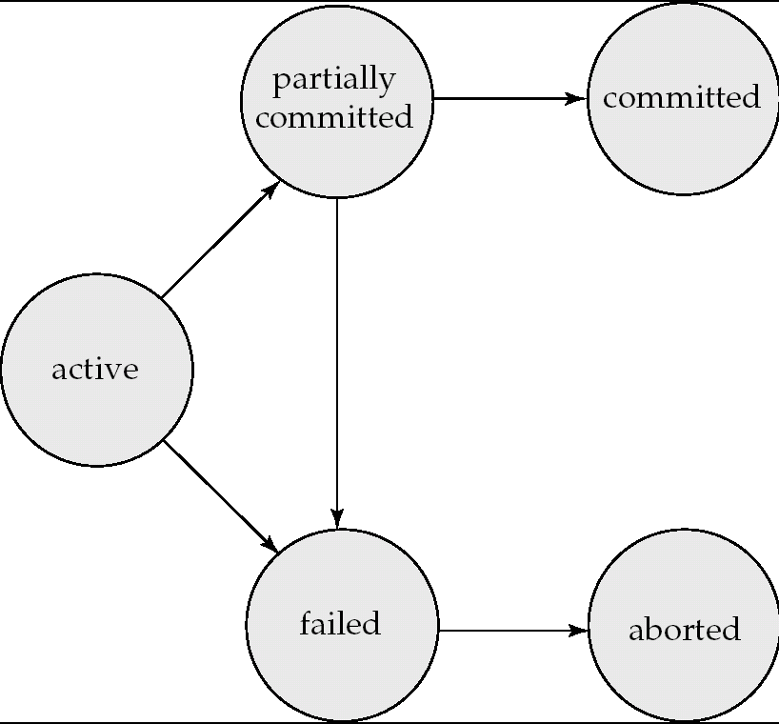
Transaction State (Cont.)

Slide 8
Implementation of Atomicity and Durability
The recovery-management component of a database system implements the support for atomicity and durability.
The shadow-database scheme:
assume that only one transaction is active at a time.
a pointer called db_pointer always points to the current consistent copy of the database.
all updates are made on a shadow copy of the database, and db_pointer is made to point to the updated shadow copy only after the transaction reaches partial commit and all updated pages have been flushed to disk.
in case transaction fails, old consistent copy pointed to by db_pointer can be used, and the shadow copy can be deleted.

Slide 9
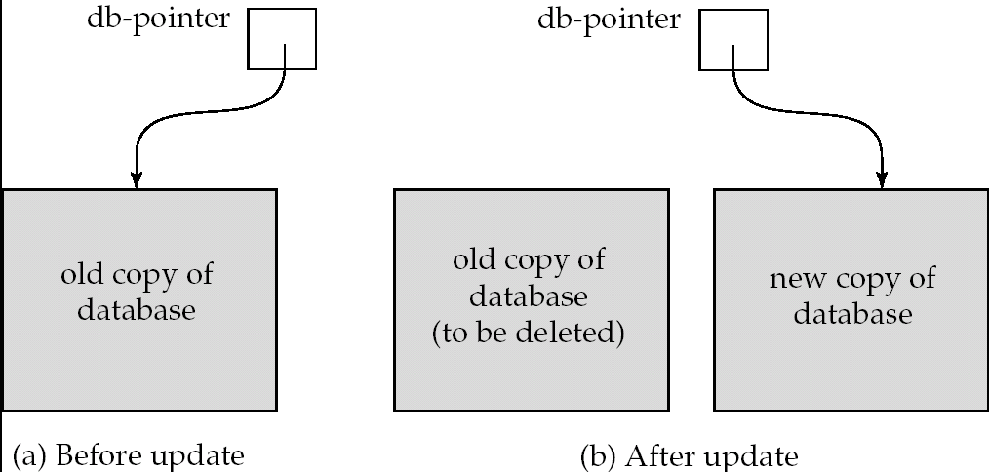
Implementation of Atomicity and Durability (Cont.)
The shadow-database scheme:
Assumes disks do not fail
Useful for text editors, but
extremely inefficient for large databases
Does not handle concurrent transactions

Slide 10
Concurrent Executions
Multiple transactions are allowed to run concurrently in the system. Advantages are:
increased processor and disk utilization, leading to better transaction throughput: one transaction can be using the CPU while another is reading from or writing to the disk
reduced average response time for transactions: short transactions need not wait behind long ones.
Concurrency control schemes – mechanisms to achieve isolation; that is, to control the interaction among the concurrent transactions in order to prevent them from destroying the consistency of the database

Slide 11
Schedules
Schedule – a sequences of instructions that specify the chronological order in which instructions of concurrent transactions are executed
a schedule for a set of transactions must consist of all instructions of those transactions
must preserve the order in which the instructions appear in each individual transaction.
A transaction that successfully completes its execution will have a commit instructions as the last statement (will be omitted if it is obvious)
A transaction that fails to successfully complete its execution will have an abort instructions as the last statement (will be omitted if it is obvious)

Slide 12
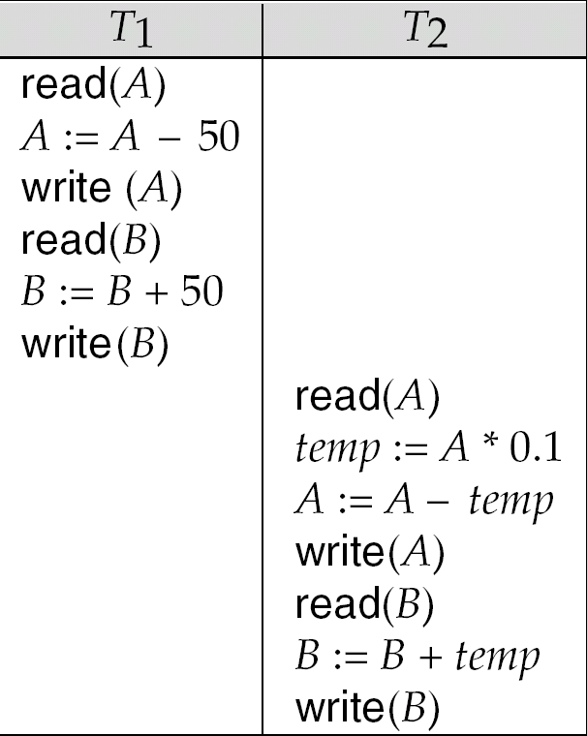
Schedule 1
Let T₁ transfer $50 from A to B, and T₂ transfer 10% of the balance from A to B.
A serial schedule in which T₁ is followed by T₂:

Slide 13
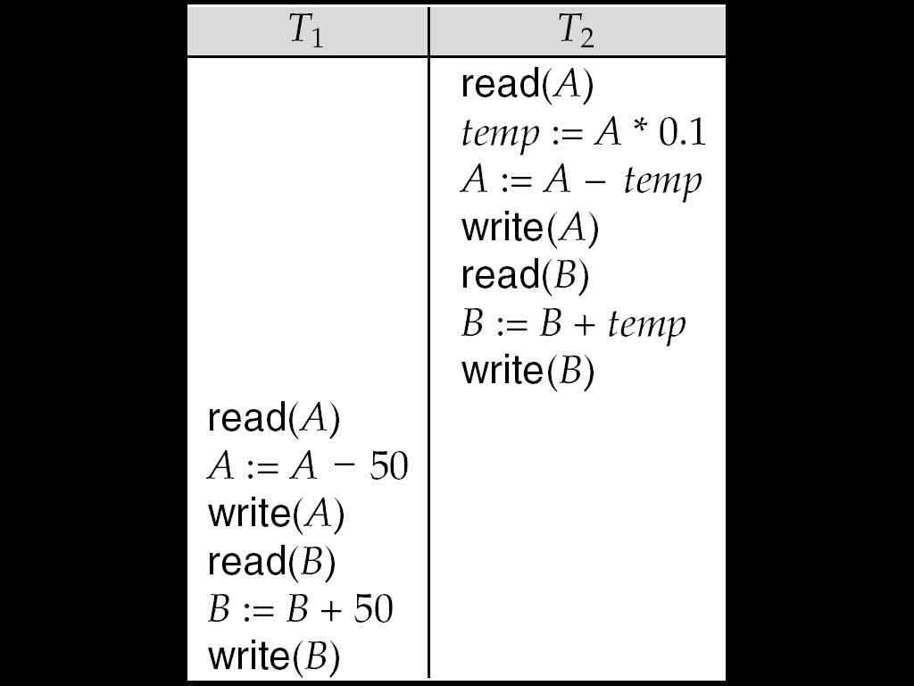
Schedule 2
A serial schedule where T₂ is followed by T₁

Slide 14
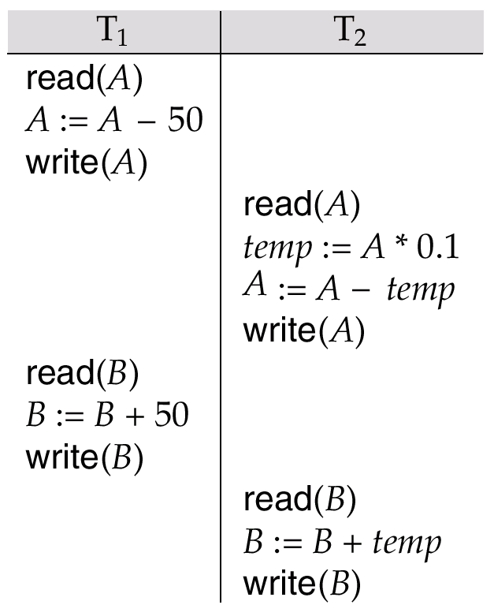
Schedule 3
Let T₁ and T₂ be the transactions defined previously. The following schedule is not a serial schedule, but it is equivalent to Schedule 1.
In Schedules 1, 2 and 3, the sum A + B is preserved.

Slide 15
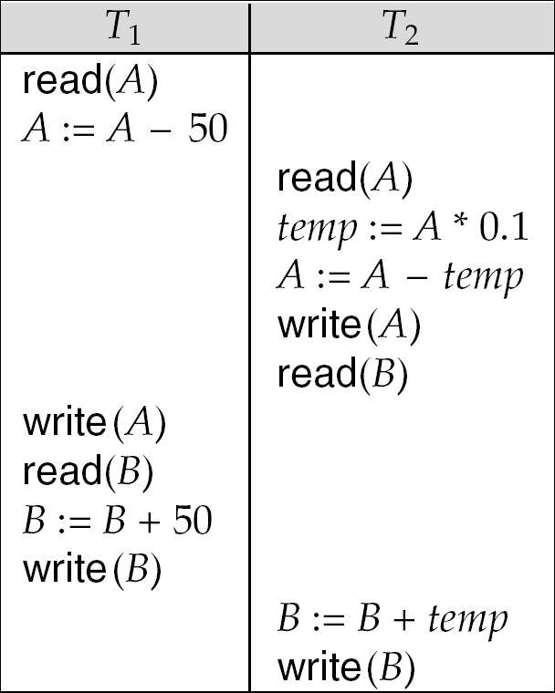
Schedule 4
The following concurrent schedule does not preserve the value of (A + B).

Slide 16
Anomalies with interleaved execution
Two actions on the same data object conflict if at least one of them is a write.
We’ll now consider three ways in which a schedule involving two consistency-preserving transactions can leave a consistent database inconsistent

Slide 17
WR conflicts
Transaction T2 reads a database object that has been modified by T1 which has not committed
T1: R(a),W(a), R(b),W(b),C
T2: R(a),W(a),R(b),W(b),C
Debit €100
from a
Credit €100
to b
Read a and b
and add 6%
interest
“Dirty
read”

Slide 18
RW conflicts
Transaction T2 could change the value of an object that has been read by a transaction T1, while T1 is still in progress
T1: R(a), R(a), W(a), C
T2: R(a),W(a),C
T1: R(a), W(a),C
T2: R(a), W(a),C
“Unrepeatable
Read”
Read A (5)
Write 5+1=6
A is 4 ☹
Read A (5)
Write 5-1=4

Slide 19
WW conflicts
Transaction T2 could overwrite the value of an object which has already been modified by T1, while T1 is still in progress
T1: [W(Britney), W(gmb)] “Set both salaries at $1000”
T2: [W(gmb), W(Britney)] “Set both salaries at $2000”
But:
T1: W(Britney), W(gmb)
T2: W(gmb), W(Britney)
“Blind Write or lost update”
gmb gets $1000
Britney gets $2000
☺

Slide 20
Serialisability and aborts
Things are more complicated when transactions can abort
T1:R(a), W(a), Abort
T2: R(a),W(a),R(b),W(b),C
Deduct €100
from a
Can’t undo T2
It’s committed ☹
Add 6% interest
to a and b

Slide 21
Serializability
Basic Assumption – Each transaction preserves database consistency.
Thus serial execution of a set of transactions preserves database consistency.
A (possibly concurrent) schedule is serializable if it is equivalent to a serial schedule. Different forms of schedule equivalence give rise to the notions of:
1. conflict serializability
2. view serializability
We ignore operations other than read and write instructions, and we assume that transactions may perform arbitrary computations on data in local buffers in between reads and writes. Our simplified schedules consist of only read and write instructions.

Slide 22
Conflicting Instructions
Instructions l_{i} and l_{j} of transactions T_{i} and T_{j} respectively, conflict if and only if there exists some item Q accessed by both l_{i} and l_{j}, and at least one of these instructions wrote Q.
1. l_{i} = read(Q), l_{j} = read(Q). l_{i} and l_{j} don’t conflict. 2. l_{i} = read(Q), l_{j} = write(Q). They conflict. 3. l_{i} = write(Q), l_{j} = read(Q). They conflict 4. l_{i} = write(Q), l_{j} = write(Q). They conflict
Intuitively, a conflict between l_{i} and l_{j} forces a (logical) temporal order between them.
If l_{i} and l_{j} are consecutive in a schedule and they do not conflict, their results would remain the same even if they had been interchanged in the schedule.

Slide 23
Conflict Serializability
If a schedule S can be transformed into a schedule S´ by a series of swaps of non-conflicting instructions, we say that S and S´ are conflict equivalent.
We say that a schedule S is conflict serializable if it is conflict equivalent to a serial schedule

Slide 24
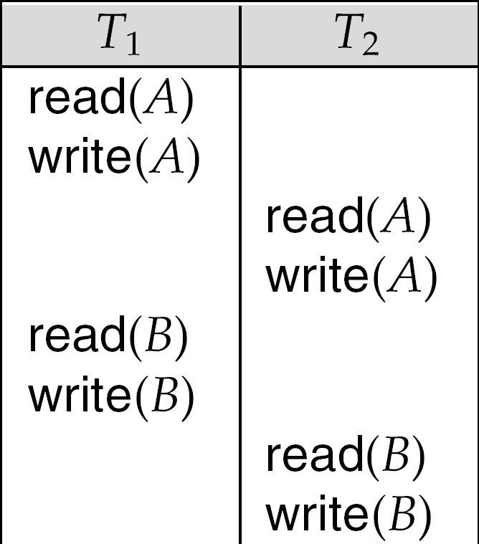
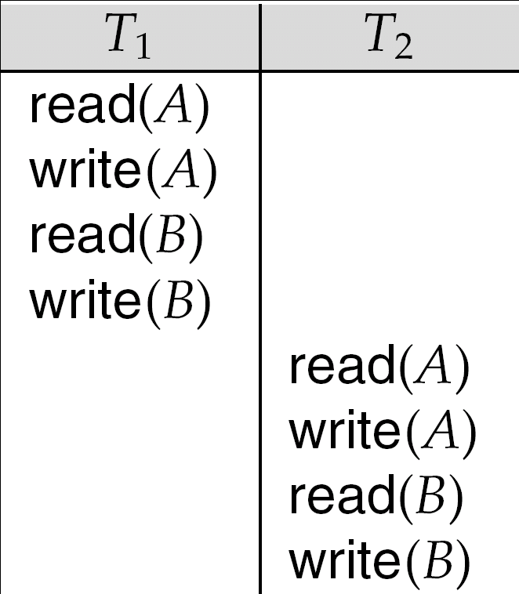
Conflict Serializability (Cont.)
Schedule 3 can be transformed into Schedule 6, a serial schedule where T₂ follows T₁, by series of swaps of non-conflicting instructions.
Therefore Schedule 3 is conflict serializable.
Schedule 3
Schedule 6

Slide 25
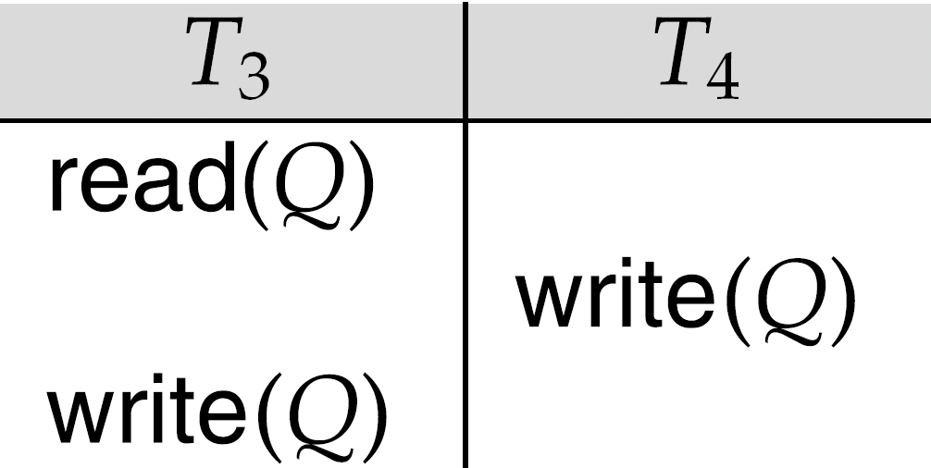
Conflict Serializability (Cont.)
Example of a schedule that is not conflict serializable:
We are unable to swap instructions in the above schedule to obtain either the serial schedule < T₃, T₄ >, or the serial schedule < T₄, T₃ >.

Slide 26
View Serializability
Let S and S´ be two schedules with the same set of transactions. S and S´ are view equivalent if the following three conditions are met:
1. For each data item Q, if transaction T_{i} reads the initial value of Q in schedule S, then transaction T_{i} must, in schedule S´, also read the initial value of Q.
2. For each data item Q if transaction T_{i} executes read(Q) in schedule S, and that value was produced by transaction T_{j} (if any), then transaction T_{i} must in schedule S´ also read the value of Q that was produced by transaction T_{j} .
3. For each data item Q, the transaction (if any) that performs the final write(Q) operation in schedule S must perform the final write(Q) operation in schedule S´.
As can be seen, view equivalence is also based purely on reads and writes alone.

Slide 27
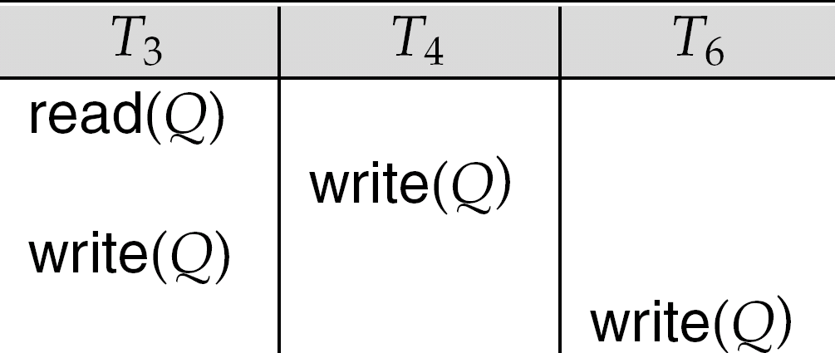
View Serializability (Cont.)
A schedule S is view serializable it is view equivalent to a serial schedule.
Every conflict serializable schedule is also view serializable.
Below is a schedule which is view-serializable but not conflict serializable.
What serial schedule is above equivalent to?
Every view serializable schedule that is not conflict serializable has blind writes.

Slide 28
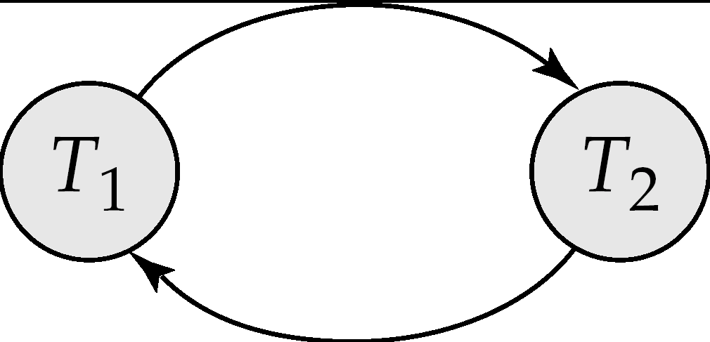
Testing for Serializability
Consider some schedule of a set of transactions T₁, T₂, ..., T_{n}
Precedence graph — a direct graph where the vertices are the transactions (names).
We draw an arc from T_{i} to T_{j} if the two transaction conflict, and T_{i} accessed the data item on which the conflict arose earlier.
We may label the arc by the item that was accessed.
Example 1
x
The set of edges consists of all edges
Ti →Tj for which one of three conditions holds:
1. Ti executes write(Q) before Tj executes read(Q).
2. Ti executes read(Q) before Tj executes write(Q).
3. Ti executes write(Q) before Tj executes write(Q).
y

Slide 29
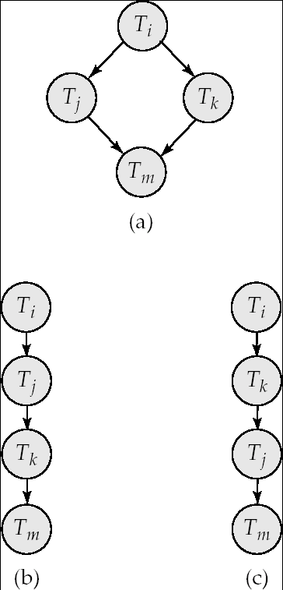
Test for Conflict Serializability
A schedule is conflict serializable if and only if its precedence graph is acyclic.
Cycle-detection algorithms exist which take order n² time, where n is the number of vertices in the graph.
If precedence graph is acyclic, the serializability order can be obtained by a topological sorting of the graph.
This is a linear order consistent with the partial order of the graph.
For example, a serializability order for Schedule A would be Ti → Tj → Tk → T_{m}
Are there others?

Slide 30
Test for View Serializability
The precedence graph test for conflict serializability cannot be used directly to test for view serializability.
Extension to test for view serializability has cost exponential in the size of the precedence graph.
The problem of checking if a schedule is view serializable falls in the class of NP-complete problems.
Thus existence of an efficient algorithm is extremely unlikely.

Slide 31
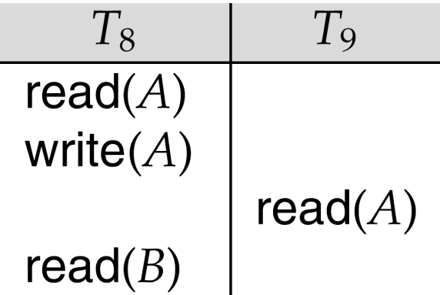
Recoverable Schedules
Need to address the effect of transaction failures on concurrently running transactions.
Recoverable schedule — if a transaction T_{j} reads a data item previously written by a transaction T_{i} , then the commit operation of T_{i} appears before the commit operation of T_{j}.
The following schedule (Schedule 11) is not recoverable if T₉ commits immediately after the read
If T₈ should abort, T₉ would have read (and possibly shown to the user) an inconsistent database state. Hence, database must ensure that schedules are recoverable.

Slide 32
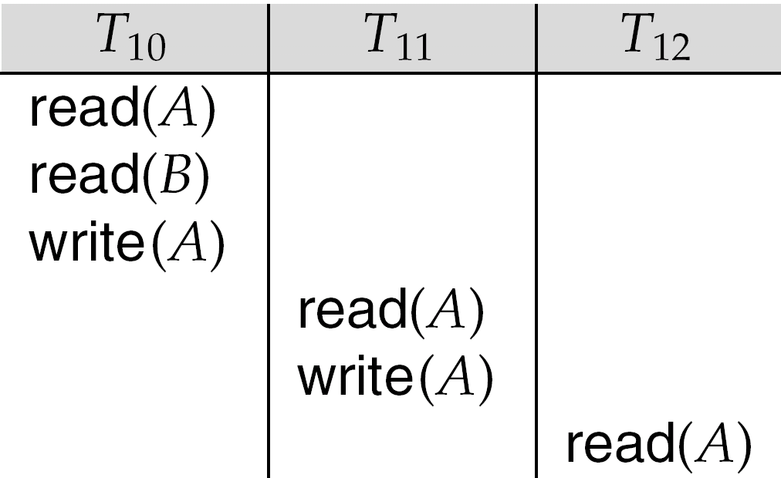
Cascading Rollbacks
Cascading rollback – a single transaction failure leads to a series of transaction rollbacks. Consider the following schedule where none of the transactions has yet committed (so the schedule is recoverable) If T₁₀ fails, T₁₁ and T₁₂ must also be rolled back.
Can lead to the undoing of a significant amount of work

Slide 33
Cascadeless Schedules
Cascadeless schedules — cascading rollbacks cannot occur; for each pair of transactions T_{i} and T_{j} such that T_{j} reads a data item previously written by T_{i}, the commit operation of T_{i} appears before the read operation of T_{j}.
Every cascadeless schedule is also recoverable
It is desirable to restrict the schedules to those that are cascadeless

Slide 34
Concurrency Control
A database must provide a mechanism that will ensure that all possible schedules are
either conflict or view serializable, and
are recoverable and preferably cascadeless
A policy in which only one transaction can execute at a time generates serial schedules, but provides a poor degree of concurrency
Are serial schedules recoverable/cascadeless?
Testing a schedule for serializability after it has executed is a little too late!
Goal – to develop concurrency control protocols that will assure serializability.

Slide 35
Concurrency Control vs. Serializability Tests
Concurrency-control protocols allow concurrent schedules, but ensure that the schedules are conflict/view serializable, and are recoverable and cascadeless.
Concurrency control protocols generally do not examine the precedence graph as it is being created
Instead a protocol imposes a discipline that avoids nonseralizable schedules.
Different concurrency control protocols provide different tradeoffs between the amount of concurrency they allow and the amount of overhead that they incur.
Tests for serializability help us understand why a concurrency control protocol is correct.

Slide 36
Lock-Based Protocols
A lock is a mechanism to control concurrent access to a data item
Data items can be locked in two modes :
1. exclusive (X) mode. Data item can be both read as well as written. X-lock is requested using lock-X instruction.
2. shared (S) mode. Data item can only be read. S-lock is requested using lock-S instruction.
Lock requests are made to concurrency-control manager. Transaction can proceed only after request is granted.

Slide 37
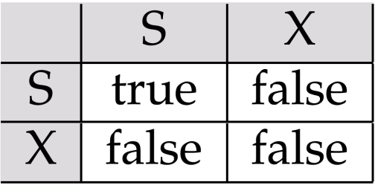
Lock-Based Protocols (Cont.)
Lock-compatibility matrix
A transaction may be granted a lock on an item if the requested lock is compatible with locks already held on the item by other transactions
Any number of transactions can hold shared locks on an item,
but if any transaction holds an exclusive on the item no other transaction may hold any lock on the item.
If a lock cannot be granted, the requesting transaction is made to wait till all incompatible locks held by other transactions have been released. The lock is then granted.

Slide 38
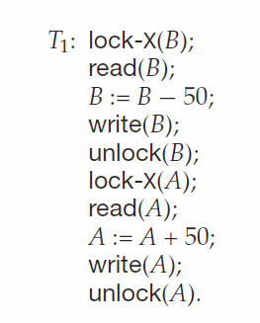
Lock-Based Protocols (Cont.)
Example of a transaction performing locking:
T₂: lock-S(A);
read (A);
unlock(A);
lock-S(B);
read (B);
unlock(B);
display(A+B)
Locking as above is not sufficient to guarantee serializability — if A and B get updated in-between the read of A and B, the displayed sum would be wrong.
A locking protocol is a set of rules followed by all transactions while requesting and releasing locks. Locking protocols restrict the set of possible schedules.

Slide 39
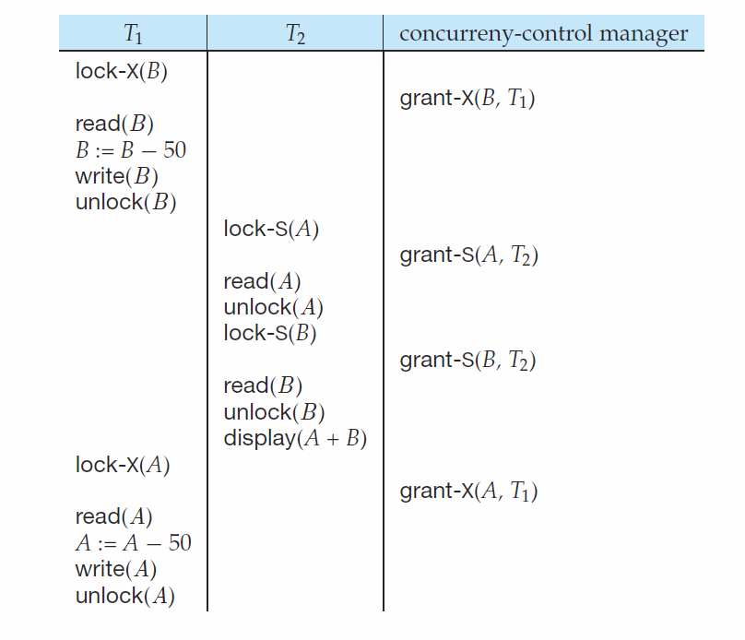

Slide 40
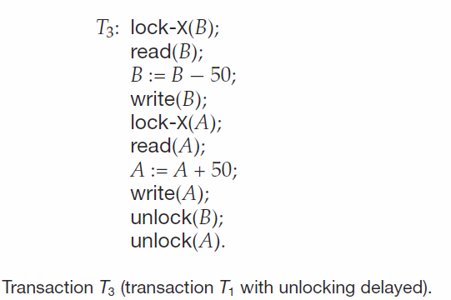
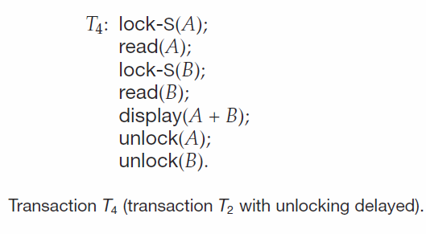

Slide 41
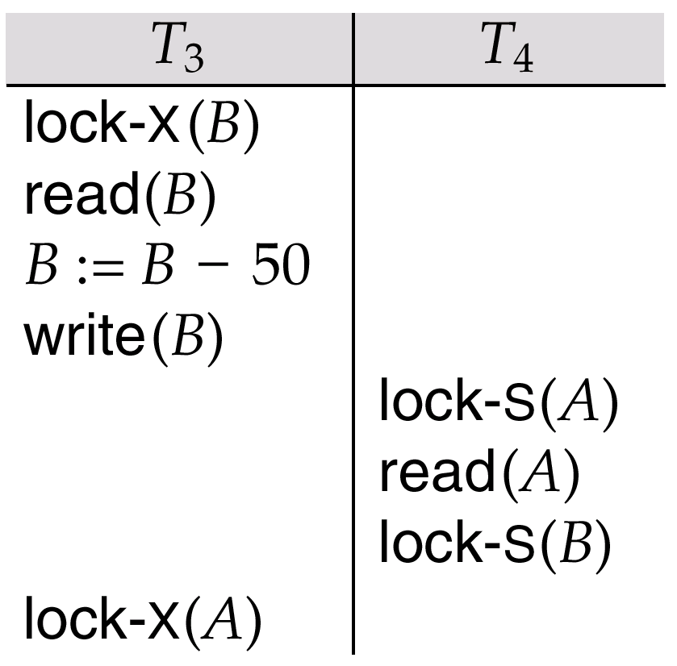
Pitfalls of Lock-Based Protocols
Consider the partial schedule
Neither T₃ nor T₄ can make progress — executing lock-S(B) causes T₄ to wait for T₃ to release its lock on B, while executing lock-X(A) causes T₃ to wait for T₄ to release its lock on A.
Such a situation is called a deadlock.
To handle a deadlock one of T₃ or T₄ must be rolled back and its locks released.

Slide 42
Pitfalls of Lock-Based Protocols (Cont.)
The potential for deadlock exists in most locking protocols. Deadlocks are a necessary evil.
Starvation is also possible if concurrency control manager is badly designed. For example:
A transaction may be waiting for an X-lock on an item, while a sequence of other transactions request and are granted an S-lock on the same item.
The same transaction is repeatedly rolled back due to deadlocks.
Concurrency control manager can be designed to prevent starvation.

Slide 43
The Two-Phase Locking Protocol
This is a protocol which ensures conflict-serializable schedules.
Phase 1: Growing Phase
transaction may obtain locks
transaction may not release locks
Phase 2: Shrinking Phase
transaction may release locks
transaction may not obtain locks
The protocol assures serializability. It can be proved that the transactions can be serialized in the order of their lock points (i.e. the point where a transaction acquired its final lock).

Slide 44
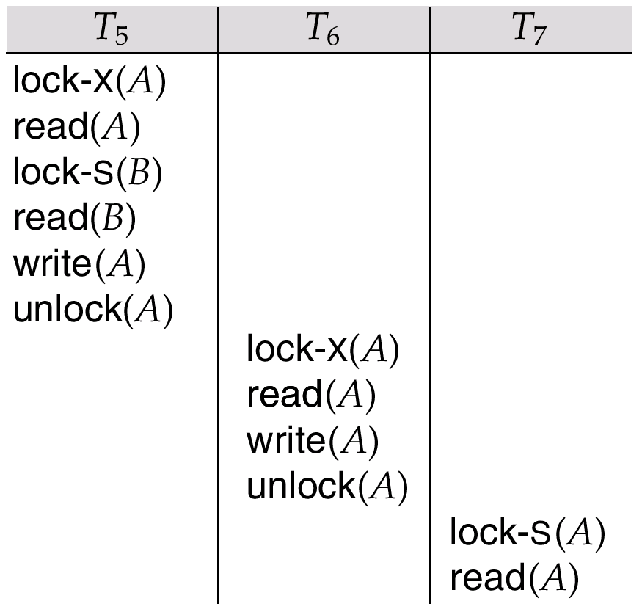
The Two-Phase Locking Protocol (Cont.)
Two-phase locking does not ensure freedom from deadlocks
Cascading roll-back is possible under two-phase locking. To avoid this, follow a modified protocol called strict two-phase locking. Here a transaction must hold all its exclusive locks till it commits/aborts.
Rigorous two-phase locking is even stricter: here all locks are held till commit/abort. In this protocol transactions can be serialized in the order in which they commit.

Slide 45
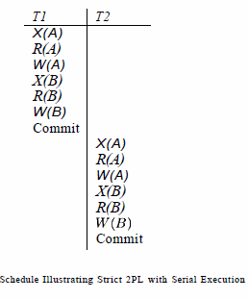
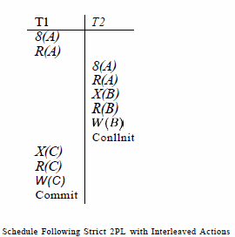

Slide 46
Aborting
If a transaction Ti is aborted, then all actions must be undone
Also, if Tj reads object last written by Ti, then Tj must be aborted!
Most systems avoid cascading aborts by releasing locks only at commit time (strict protocols)
If Ti writes an object, then Tj can only read this after Ti finishes
In order to undo changes, the DBMS maintains a log which records every write

Slide 47
Lock-Based Concurrency Control
Strict Two-phase Locking (Strict 2PL) Protocol:
Each Xact must obtain a S (shared) lock on object before reading, and an X (exclusive) lock on object before writing.
All locks held by a transaction are released when the transaction completes
(Non-strict) 2PL Variant: Release locks anytime, but cannot acquire locks after releasing any lock.
If an Xact holds an X lock on an object, no other Xact can get a lock (S or X) on that object.
Strict 2PL allows only serializable schedules.
Additionally, it simplifies transaction aborts
(Non-strict) 2PL also allows only serializable schedules, but involves more complex abort processing

Slide 48
Conservative 2PL
Lock all items it needs then transaction starts execution
If any locks can not be obtained, then do not lock anything
Difficult but deadlock free
first action starts
locks
growing
shrinking
time

Slide 49
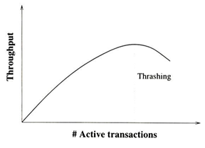
Performance of Locking
Lock Thrashing
Delays due to blocking increases with the number of active transactions and throughput increases more slowly than number of active transactions.
Adding another transaction may reduce the throughput at some point of time
Throughput can be increased in three ways
By locking the smallest sized objects possible
By reducing the time that transaction hold locks
By reducing hotspots

Slide 50
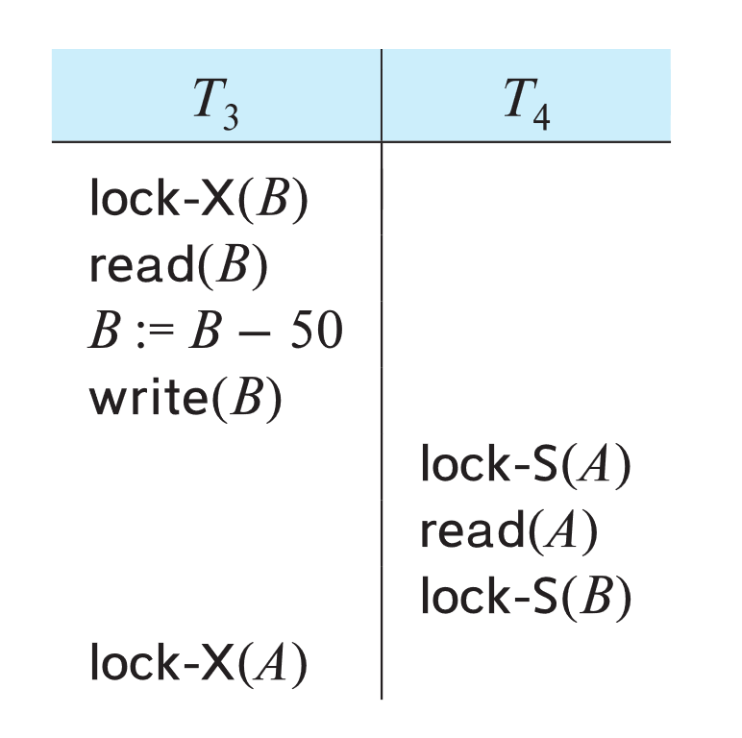
Deadlocks
Deadlock: Cycle of transactions waiting for locks to be released by each other.
Two ways of dealing with deadlocks:
Deadlock prevention
Deadlock detection
Deadlock Recovery

Slide 51
Deadlock Prevention
Deadlock prevention protocols ensure that the system will never enter into a deadlock state. Some prevention strategies:
Require that each transaction locks all its data items before it begins execution (pre-declaration).

Slide 52
Prevention Strategies
Assign priorities based on timestamps. Assume Ti wants a lock that Tj holds. Two policies are possible:
Wait-Die: If Ti has higher priority, Ti waits for Tj; otherwise Ti aborts(non-preemptive)
Wound-wait: If Ti has higher priority, Tj aborts; otherwise Ti waits(preemptive)
If a transaction re-starts, make sure it has its original timestamp
Timeout-Based Schemes:
A transaction waits for a lock only for a specified amount of time. After that, the wait times out and the transaction is rolled back.
Ensures that deadlocks get resolved by timeout if they occur

Slide 53
Deadlock Detection
Create a waits-for graph:
Nodes are transactions
There is an edge from Ti to Tj if Ti is waiting for Tj to release a lock
Periodically check for cycles in the waits-for graph

Slide 54
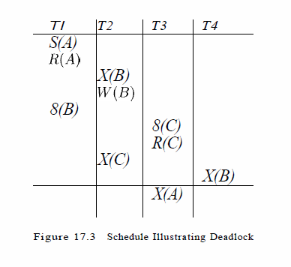
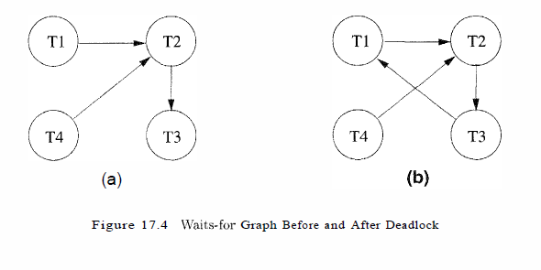

Slide 55
Deadlock Recovery
When deadlock is detected :
Some transaction will have to rolled back (made a victim) to break deadlock cycle.
Select that transaction as victim that will incur minimum cost
Rollback -- determine how far to roll back transaction
Total rollback: Abort the transaction and then restart it.
Partial rollback: Roll back victim transaction only as far as necessary to release locks that another transaction in cycle is waiting for
Starvation can happen
One solution: oldest transaction in the deadlock set is never chosen as victim

Slide 56
Log-Based Recovery
A log is a sequence of log records. The records keep information about update activities on the database.
The log is kept on stable storage
When transaction T_{i} starts, it registers itself by writing a
<T_{i} start> log record
Before T_{i} executes write(X), a log record
<T_{i}, X, V₁, V₂>
is written, where V₁ is the value of X before the write (the old
value), and V₂ is the value to be written to X (the new value).
When T_{i} finishes it last statement, the log record <T_{i} commit> is written.
Two approaches using logs
Immediate database modification
Deferred database modification.

Slide 57
The immediate-modification scheme allows updates of an uncommitted transaction to be made to the buffer, or the disk itself, before the transaction commits
Update log record must be written before database item is written
We assume that the log record is output directly to stable storage
Output of updated blocks to disk can take place at any time before or after transaction commit
Order in which blocks are output can be different from the order in which they are written.
The deferred-modification scheme performs updates to buffer/disk only at the time of transaction commit
Simplifies some aspects of recovery
But has overhead of storing local copy

Slide 58
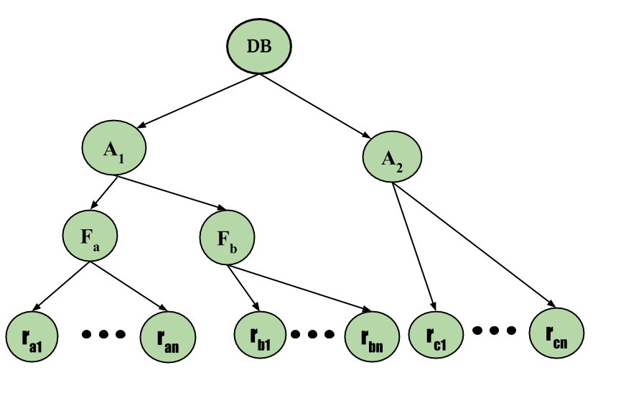
Intent Lock
Intention Mode Lock – In addition to S and X lock modes, there are three additional lock modes with multiple granularities:
Intention-Shared (IS): explicit locking at a lower level of the tree but only with shared locks.
Intention-Exclusive (IX): explicit locking at a lower level with exclusive or shared locks.
Shared & Intention-Exclusive (SIX): the subtree rooted by that node is locked explicitly in shared mode and explicit locking is being done at a lower level with exclusive mode locks.

Slide 59
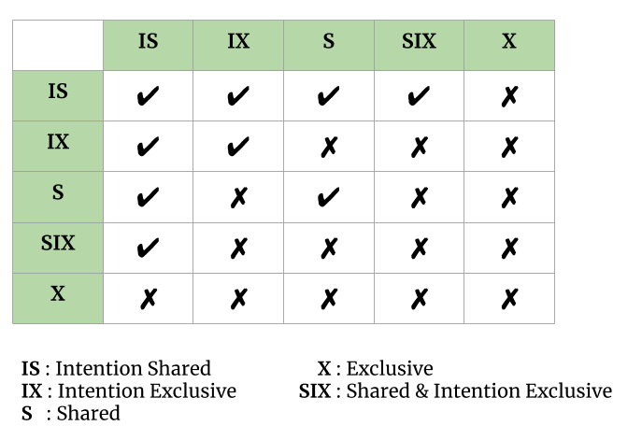
The compatibility matrix for these lock modes are described below:

